Slide 1
Math analysis
Day 48

Slide 2
Objective
Install Bricklayer (those that are left)
Code in Bricklayer
Bricklayer Quiz
Organize Documentation
Main Project

Slide 3
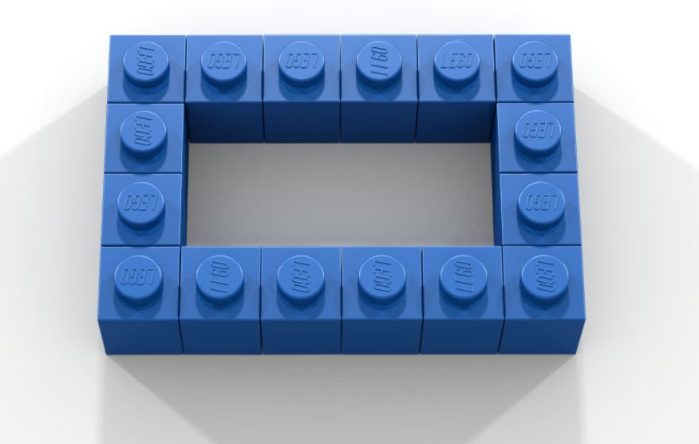
Bricklayer Intro Code (Can you give it a height? Make it striped as you move up?)

Slide 4
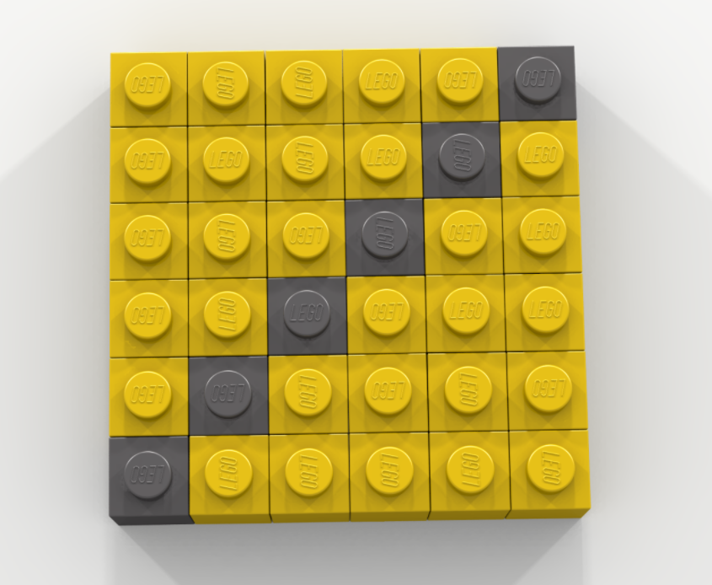
Bricklayer Intro Code

Slide 5
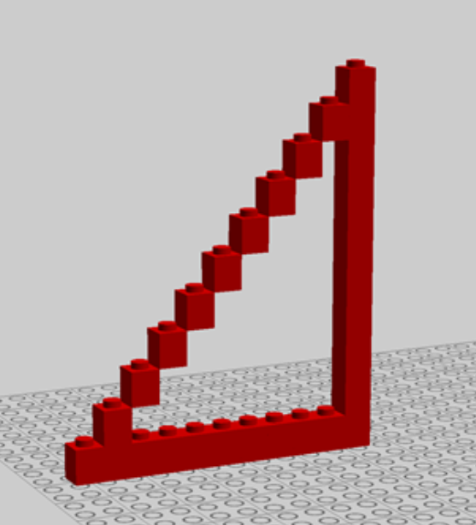
Bricklayer Intro Code

Slide 6

Bricklayer Intro Code

Slide 7
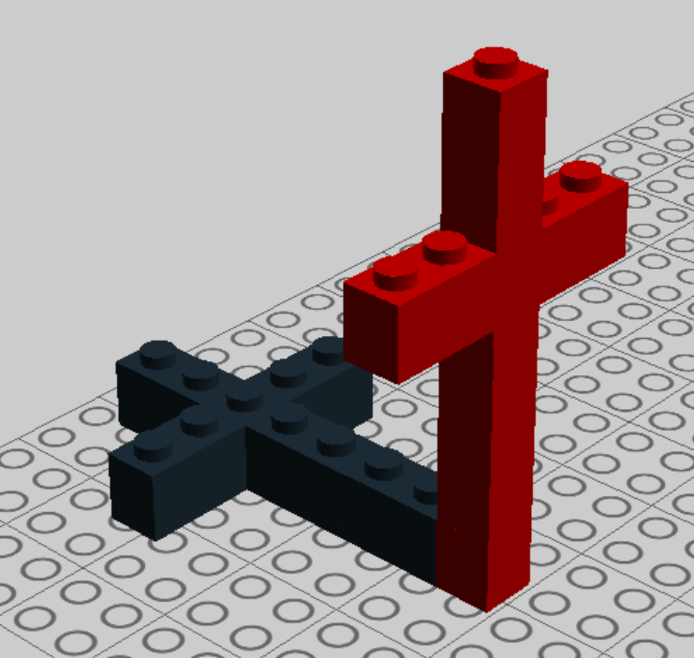
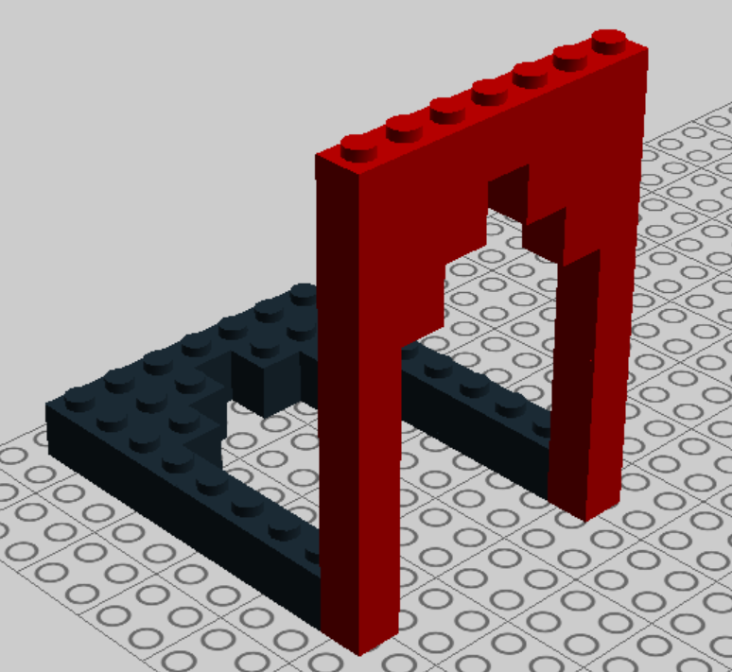
Bricklayer Design Quiz

Slide 8
Documentation
Create a file and copy and paste in documentation that you think will be helpful.
Include the link so you can easily find it later.

Slide 9
Major Project
Bryan High School (6 – 8 students?)
What else could we build?
In Omaha? Nebraska? USA? The World?

Slide 10
Major Project Groups
Bryan High School
Alyssa, Pieter, Emily, Nicole, Fernando, Patrik, Adriana, Edwin
________
________

Slide 11
Attempt to Download Bricklayer, Lego Digital Design, and LDraw
Standard Bricklayer Setup
Bricklayer (2016.10.12) - https://bricklayerdotorg.wordpress.com/windows-download/
LEGO Digital Designer - http://ldd.lego.com/en-us/download/
LDraw - http://www.ldraw.org/article/104.html

